Slide 1
Md. Zahidul Islam
Assistant Programmer
Department of ICT
Software Requirements

Slide 2
Objectives
To introduce the concepts of user and system requirements
To describe functional and non-functional requirements

Slide 3
What is a requirement?
It may range from a high-level abstract statement of a service or of a system constraint to a detailed mathematical functional specification
This is inevitable as requirements may serve a dual function
  May be the basis for a bid for a contract - therefore must be open to interpretation
  May be the basis for the contract itself - therefore must be defined in detail
  Both these statements may be called requirements

Slide 4
Types of requirement
User requirements
  Statements in natural language plus diagrams of the services the system provides and its operational constraints. Written for customers
System requirements
  A structured document setting out detailed descriptions of the system services. Written as a contract between client and contractor
Software specification
  A detailed software description which can serve as a basis for a design or implementation. Written for developers

Slide 5
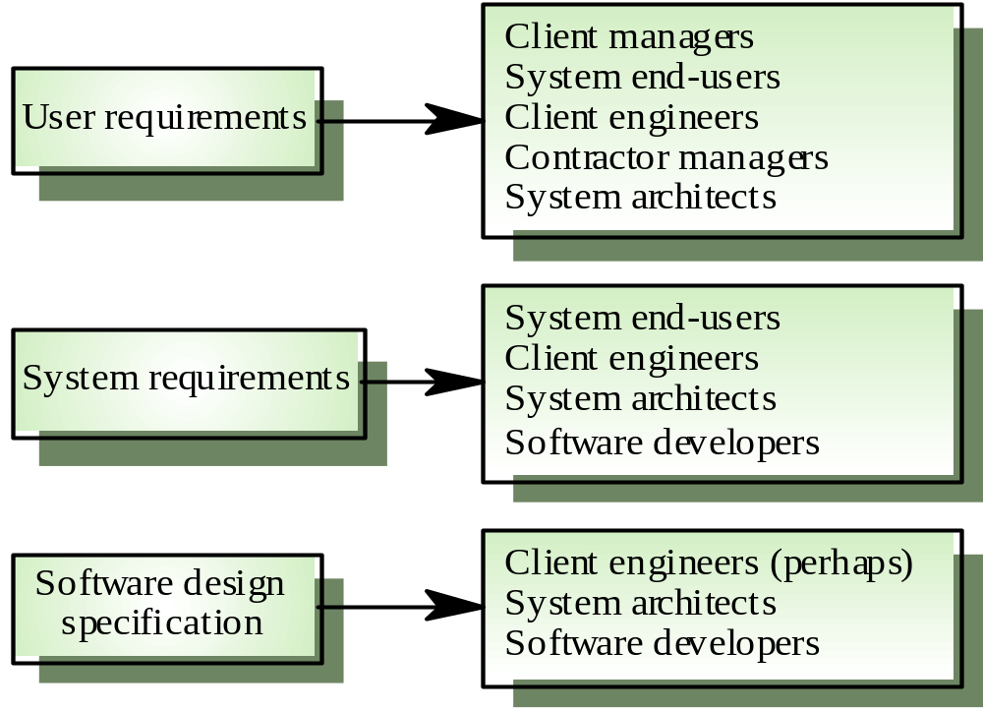
Requirements readers

Slide 6
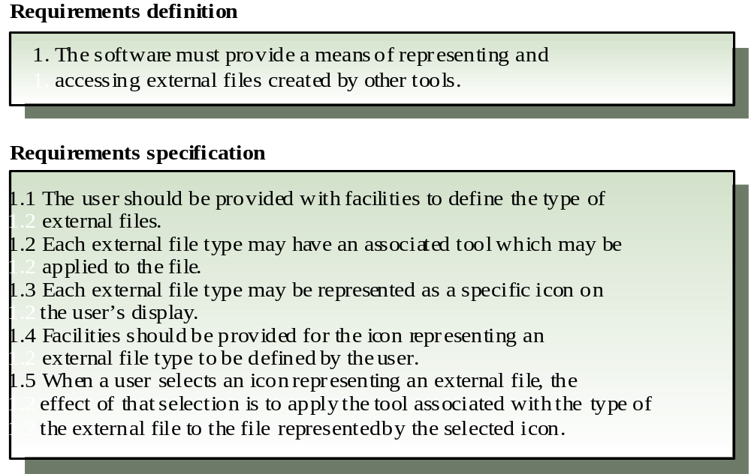
Definitions and specifications

Slide 7
Functional and non-functional requirements
Functional requirements
  Statements of services the system should provide, how the system should react to particular inputs and how the system should behave in particular situations.
Non-functional requirements
  constraints on the services or functions offered by the system such as timing constraints, constraints on the development process, standards, etc.
Domain requirements
  Requirements that come from the application domain of the system and that reflect characteristics of that domain

Slide 8
Functional requirements
Describe functionality or system services
Depend on the type of software, expected users and the type of system where the software is used
Functional user requirements may be high-level statements of what the system should do but functional system requirements should describe the system services in detail

Slide 9
Examples of functional requirements
The user shall be able to search either all of the initial set of databases or select a subset from it.
The system shall provide appropriate viewers for the user to read documents in the document store.
Every order shall be allocated a unique identifier (ORDER_ID) which the user shall be able to copy to the account’s permanent storage area.

Slide 10
Requirements imprecision
Problems arise when requirements are not precisely stated
Ambiguous requirements may be interpreted in different ways by developers and users
Consider the term ‘appropriate viewers’
  User intention - special purpose viewer for each different document type
  Developer interpretation - Provide a text viewer that shows the contents of the document

Slide 11
Requirements completeness and consistency
In principle requirements should be both complete and consistent
Complete
  They should include descriptions of all facilities required
Consistent
  There should be no conflicts or contradictions in the descriptions of the system facilities
In practice, it is impossible to produce a complete and consistent requirements document

Slide 12
Non-functional requirements
Define system properties and constraints e.g. reliability, response time and storage requirements. Constraints are I/O device capability, system representations, etc.
Process requirements may also be specified mandating a particular CASE system, programming language or development method
Non-functional requirements may be more critical than functional requirements. If these are not met, the system is useless

Slide 13
Non-functional classifications
Product requirements
  Requirements which specify that the delivered product must behave in a particular way e.g. execution speed, reliability, etc.
Organisational requirements
  Requirements which are a consequence of organisational policies and procedures e.g. process standards used, implementation requirements, etc.
External requirements
  Requirements which arise from factors which are external to the system and its development process e.g. interoperability requirements, legislative requirements, etc.

Slide 14
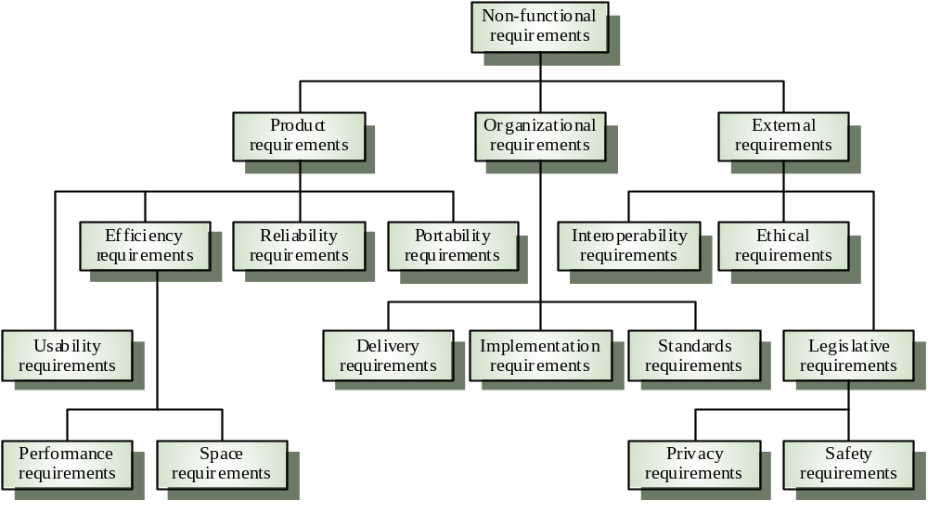
Non-functional requirement types

Slide 15
Non-functional requirements examples
Product requirement
  4.C.8 It shall be possible for all necessary communication between the APSE and the user to be expressed in the standard Ada character set
Organisational requirement
  9.3.2 The system development process and deliverable documents shall conform to the process and deliverables defined in XYZCo-SP-STAN-95
External requirement
  7.6.5 The system shall not disclose any personal information about customers apart from their name and reference number to the operators of the system

Slide 16
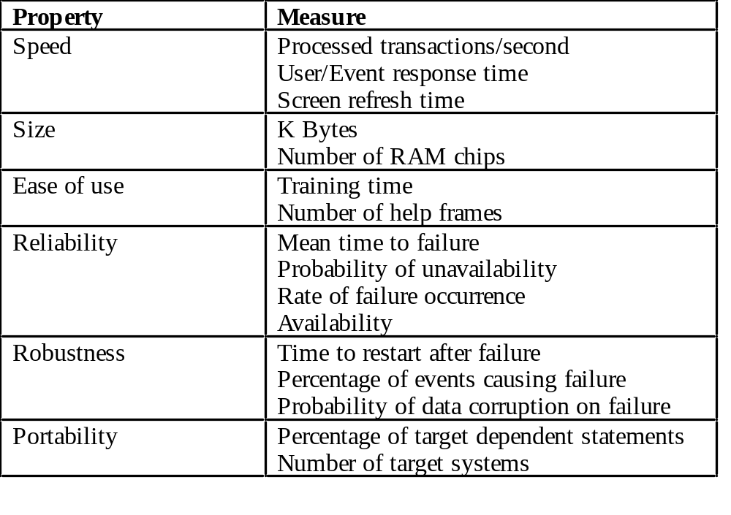
Requirements measures

Slide 17
Domain requirements
Derived from the application domain and describe system characterisics and features that reflect the domain
May be new functional requirements, constraints on existing requirements or define specific computations
If domain requirements are not satisfied, the system may be unworkable

Slide 18
Library system domain requirements
There shall be a standard user interface to all databases which shall be based on the Z39.50 standard.
Because of copyright restrictions, some documents must be deleted immediately on arrival. Depending on the user’s requirements, these documents will either be printed locally on the system server for manually forwarding to the user or routed to a network printer.

Slide 19
Domain requirements problems
Understandability
  Requirements are expressed in the language of the application domain
  This is often not understood by software engineers developing the system
Implicitness
  Domain specialists understand the area so well that they do not think of making the domain requirements explicit

Slide 20
User requirements
Should describe functional and non-functional requirements so that they are understandable by system users who don’t have detailed technical knowledge
User requirements are defined using natural language, tables and diagrams

Slide 21
Database requirement
4.A.5 The database shall support the generation and control of
configuration objects; that is, objects which are themselves groupings
of other objects in the database. The configuration control facilities
shall allow access to the objects in a version group by the use of an
incomplete name.

Slide 22
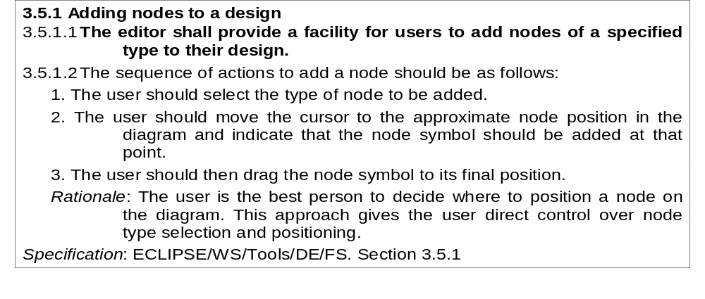
Detailed user requirement

Slide 23
System requirements
More detailed specifications of user requirements
Serve as a basis for designing the system
May be used as part of the system contract
System requirements may be expressed using system models discussed in Chapter 7

Slide 24
Requirements and design
In principle, requirements should state what the system should do and the design should describe how it does this
In practice, requirements and design are inseparable
  A system architecture may be designed to structure the requirements
  The system may inter-operate with other systems that generate design requirements
  The use of a specific design may be a domain requirement

Slide 25
Form-based specifications
Definition of the function or entity
Description of inputs and where they come from
Description of outputs and where they go to
Indication of other entities required
Pre and post conditions (if appropriate)
The side effects (if any)

Slide 26
Interface specification
Most systems must operate with other systems and the operating interfaces must be specified as part of the requirements
Three types of interface may have to be defined
  Procedural interfaces
  Data structures that are exchanged
  Data representations
Formal notations are an effective technique for interface specification

Slide 27
Group Task
Prepare a requirement document for following system
  Functional requirement
  Non-Functional requirements
Officers club website
Hospital Appointment and Queue management system
  Aims online and front desk appointment
  Aims to display to patient during waiting for consultation
Primary school student tracking system
  Aims to provide monitor schools student coming and going
Implementation of Apache Syncope for a government organization

Slide 28
Thank you

